Slide 1


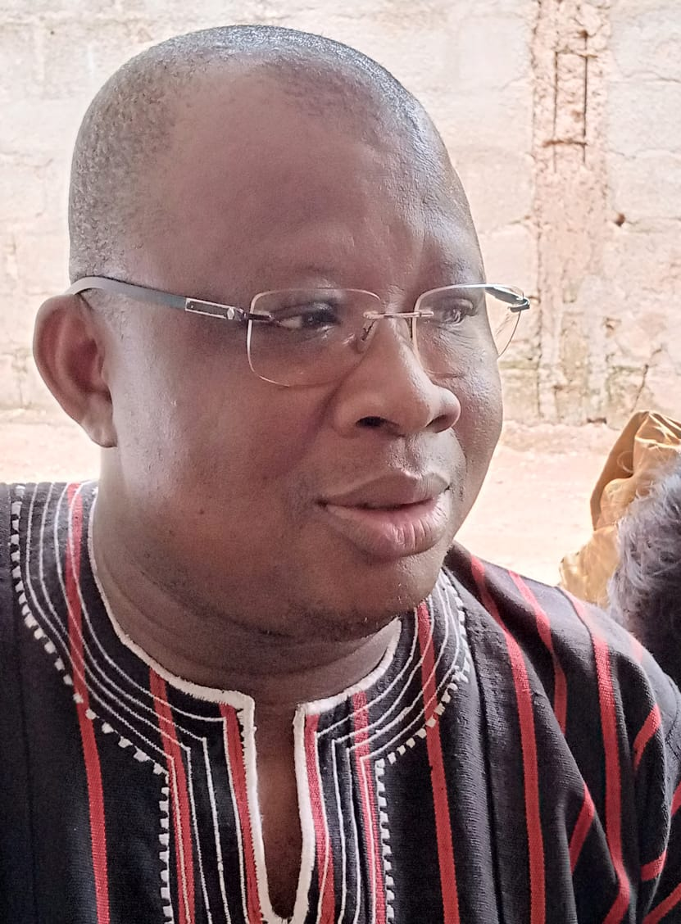
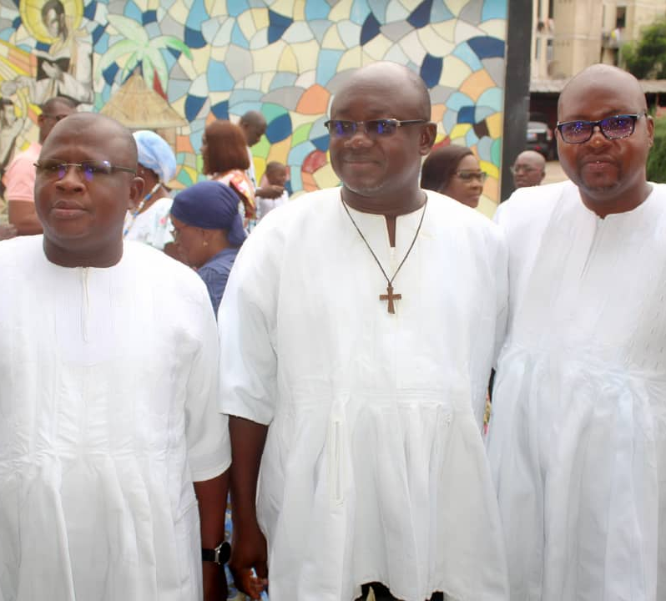
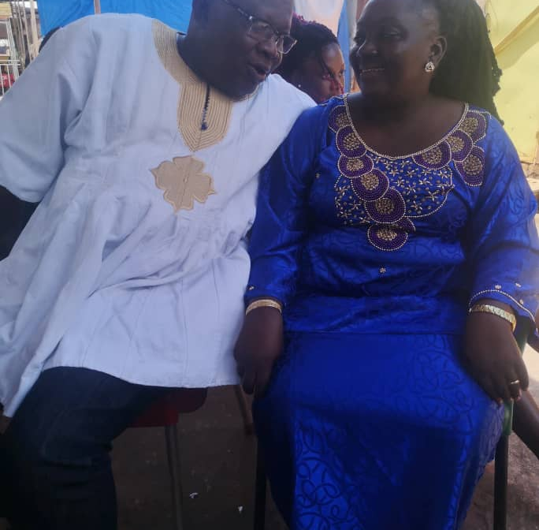
Getting to Know Me
Work
Personal
My role
Zonal Head Burkina
Significant others / family members / furry friends in my life
THIEN Isabelle
Tenure in ofi/Olam
23 year
How I enjoy spending my free time
Tinjoy with my friends
Previous companies I have worked at
Local saler with unilever
My favorite / comfort food
Foufou
Why I joined ofi/Olam and what keeps me here?
OLAM is an international company where you can build carrier
My favorite song
local Dagaties Music like Jacky MEDA
MEDA Valerien Tiyiryel
‘what name you prefer to be called MEDA’
A few fun facts about me
Sport and learning music
This is me outside work, doing stuff I enjoy in my life …

